Slide 1
Batch Effect Adjustment
Meilei Jiang
Department of Statistics and Operations Research

Slide 2
Batch Effects
Batch effects: the systematic error introduced when samples are processed in multiple batches
High dimensional low sample size data: large d and small n
Batch effects could confounded with primary effects: unbalanced batch effects

Slide 3
Batch Unsupervised Adjustment
PCA
Capture the largest variation of the data.
IRW-SVA
Iteratively Weighted SVD: weighted each gene by the probability that only affected by batch effects

Slide 4
Evaluation
Robustness again unbalanced heterogeneity
Consistency of angles against batch vector
False discovery rate under multiple testing dependence

Slide 5
Batch Supervised Adjustment
Gaussian mean heterogeneity
Linear factor model
DWD
SVM
Empirical Bayes: Combating Batch Effects
Gaussian covariance heterogeneity
Supervised-PCA
Projected-PCA
Semiparametric factor model

Slide 6
Factor model of mean heterogeneity
Data matrix X
m rows: m hypothesis tests
n columns: each test base on an n-vector of data sampled from a common probability space on R^{n}
Model X = B S + E = B S + Γ G + U
H_{0i}: b_{i} = 0 vs H_{1i}: b_{i} ≠ 0
G is the dependence kernel.
S is the basis matrix, which is known.

Slide 7
Design of Simulation
High dimension low sample size setting:
80 samples in columns, 100 genes in rows
80 samples are associated with two classes: Class 1 and Class 2.
Primary Variable Vector: y = (1_{n11}, 1_{n12}, 0_{n21}, 0_{n22})
80 samples are collected from two batches: Batch 1 and Batch 2
π₁ of samples in Class 1 are collected from Batch 1
π₂ of samples in Class 2 are collected from Batch 1
Batch Vector: y = (1_{n11}, 0_{n12}, 1_{n21}, 0_{n22})

Slide 8
Design of Simulation
Class Effect
Class 1: b₁ = 2
Class 2: b₂ = -2
Batch Effect:
Batch 1: γ₁ = 2
Batch 2: γ₂ = -2
Random Noise
N(0 , 1)

Slide 9
Design of Simulation
Balance Design: π₁ = π₂ = 0.5
Unbalance Design
Case 1: π₁ = π₂, π₁ + π₂!= 1
Batch vector and primary variable vector are uncorrelated.
Sizes of two batches are different.
Case 2: π₁ != π₂, π₁ + π₂ = 1
Batch vector and primary variable vector are correlated.
Sizes of two batches are the same.
Case 3: π₁ != π₂, π₁ + π₂ != 1
Batch vector and primary variable vector are uncorrelated.
Sizes of two batches are different.

Slide 10
Angle analysis
Surrogate variable analysis

Slide 11
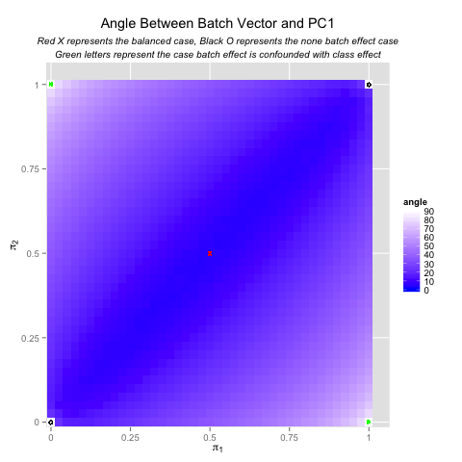
Angle analysis
PCA

Slide 12
Angle analysis
Compare SVA and PCA

Slide 13
Limitation of SVA
SVA is not robust against severe Type I unbalanced batch effect.
The success of SVA relies on the existence of the subset of genes which are only affected by batch effect

Slide 14
Limitation of PCA
The principal component of sample data set could not be consistency in high dimension low sample size setting.
PCA is not as robust as SVA for mild Type I unbalanced batch effect.

